Slide 1
Planning and Cabling Networks
Network Fundamentals – Chapter 10

Slide 2
Objectives
Identify the basic network media required to make a LAN connection.
Identify the types of connections for intermediate and end device connections in a LAN.
  - Identify the pin out configurations for straight-through and crossover cables.
  Identify the different cabling types, standards and ports used for WAN connections.
  Define the role of device management connections when using Cisco equipment.
Design an addressing scheme for an inter-network and assign ranges for hosts, network devices and the router interface.
Compare and contrast the importance of network designs

Slide 3
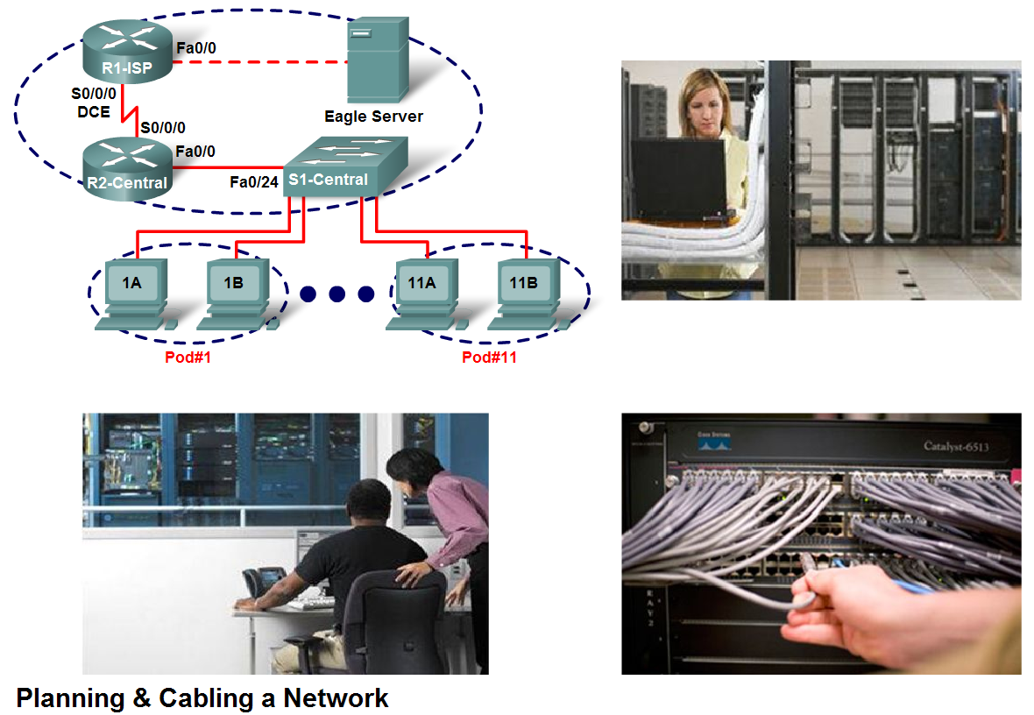
Basic Network Media Required to Make a LAN Connection.
Select the appropriate hardware, including the cabling, to install several computers together in a LAN

Slide 4
Overview
Before using an IP phone, accessing instant messaging, or conducting any number of other interactions over a data network, we must connect end devices and intermediary devices via cable or wireless connections to form a functioning network.
It is this network that will support our communication in the human network.
Up to this point in the course, we have considered the services that a data network can provide to the human network, examined the features of each layer of the OSI model and the operations of TCP/IP protocols, and looked in detail at Ethernet, a universal LAN technology.
The next step is to learn how to assemble these elements together in a functioning network.

Slide 5
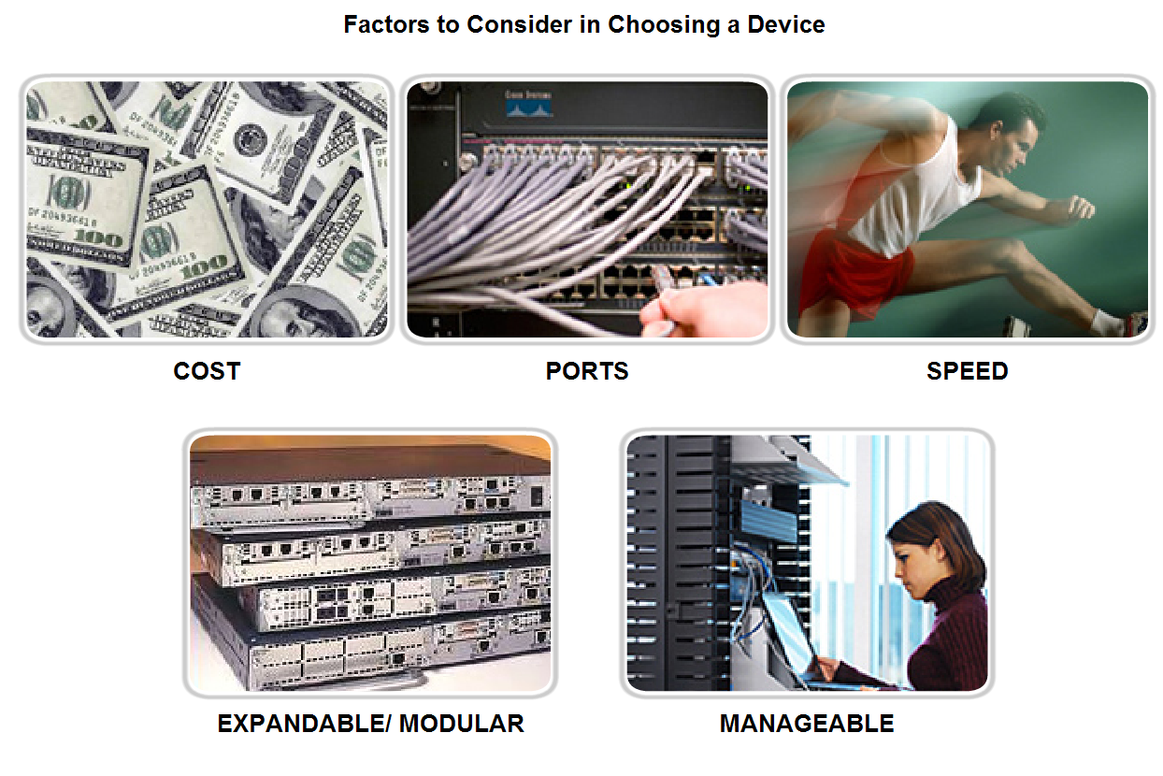
Basic Network Media Required to Make a LAN Connection.
To identify some key aspects of the devices they will be employing in a LAN

Slide 6
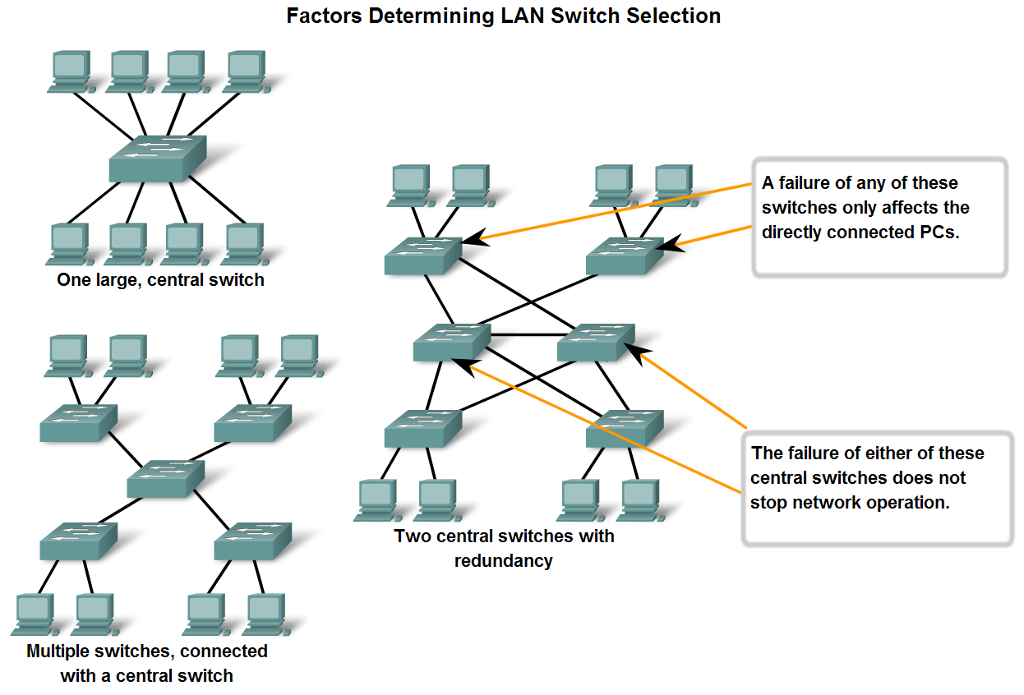
Basic Network Media Required to Make a LAN Connection.
Connect two computers with a switch

Slide 7
Cost
The cost of a switch is determined by its capacity and features.
The switch capacity includes the number and types of ports available and the switching speed.
Other factors that impact the cost are its network management capabilities, embedded security technologies, and optional advanced switching technologies.
Using a simple "cost per port" calculation, it may appear initially that the best option is to deploy one large switch at a central location.
However, this apparent cost savings may be offset by the expense from the longer cable lengths required to connect every device on the LAN to one switch.
This option should be compared with the cost of deploying a number of smaller switches connected by a few long cables to a central switch.

Slide 8
Cost
Another cost consideration is how much to invest in redundancy.
The operation of the entire physical network is affected if there are problems with a single central switch.
Redundancy can be provided in a number of ways. We can provide a secondary central switch to operate concurrently with the primary central switch.
We can also provide additional cabling to provide multiple interconnections between the switches.
The goal of redundant systems is to allow the physical network to continue its operation even if one device fails.

Slide 9
Speed and Types of Ports/Interfaces
The need for speed is ever-present in a LAN environment. Newer computers with built-in 10/100/1000 Mbps NICs are available.
Choosing Layer 2 devices that can accommodate increased speeds allows the network to evolve without replacing the central devices.
When selecting a switch, choosing the number and type of ports is a critical decision. Ask yourself these questions: Would you purchase a switch with:
Just enough ports for today's needs?
A mixture of UTP speeds?
Both UTP and fiber ports?
Consider carefully how many UTP ports will be needed and how many fiber ports will be needed.
Likewise, consider how many ports will need 1 Gbps capability and how many ports only require 10/100 Mbps bandwidths. Also, consider how soon more ports will be needed.

Slide 10
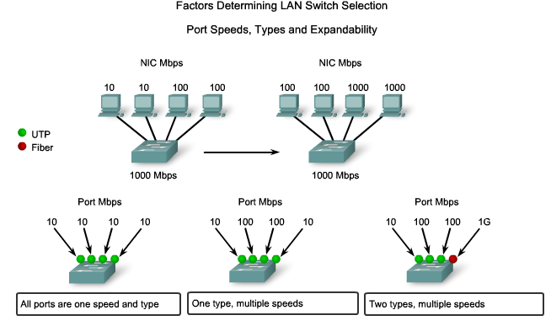
Switch Selection

Slide 11
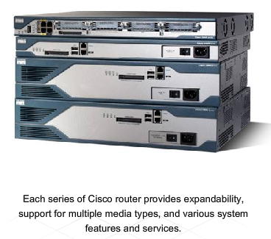
Router Selection
When selecting a router, we need to match the characteristics of the router to its purpose.
Similar to the switch, cost and interface types and speeds must be considered as well. Additional factors for choosing a router include:
Expandability
Media
Operating System Features

Slide 12
Expandability
Networking devices, such as routers and switches, come in both fixed and modular physical configurations.
Fixed configurations have a specific number and type of ports or interfaces.
Modular devices have expansion slots that provide the flexibility to add new modules as requirements evolve.
Most modular devices come with a basic number of fixed ports as well as expansion slots.
Since routers can be used for connecting different numbers and types of networks, care must be taken to select the appropriate modules and interfaces for the specific media.

Slide 13
O.S. Types
Depending on the version of the operating system, the router can support certain features and services such as:
Security
Quality of Service (QoS)
Voice over IP (VoIP)
Routing multiple Layer 3 protocols
Special services such as Network Address Translation (NAT) and Dynamic Host Configuration Protocol (DHCP)
Routers can be expensive based on interfaces and features needed.
Additional modules, such as fiber-optics, can increase the costs.
The media used to connect to the router should be supported without needing to purchase additional modules. This can keep costs to a minimum.

Slide 14
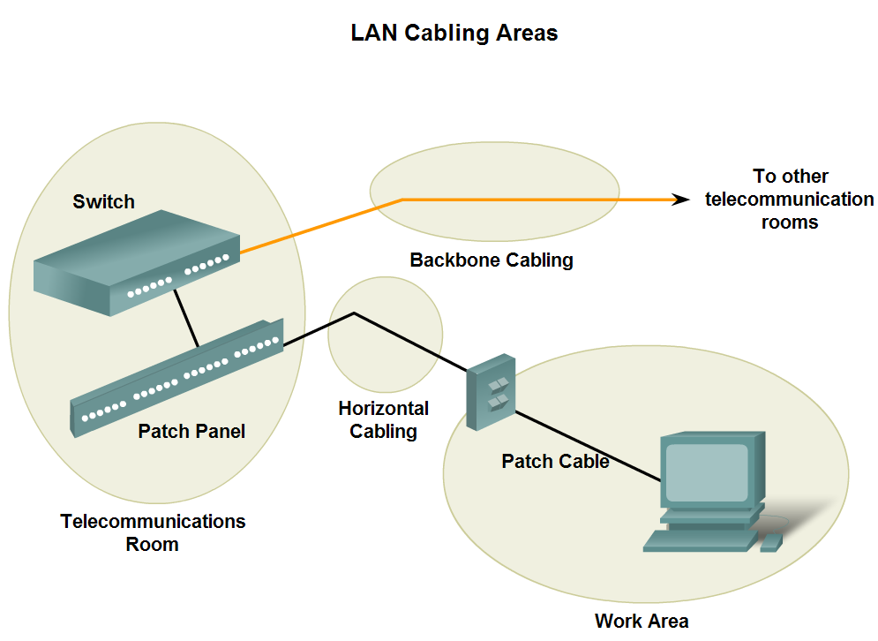
Types of Connections in a LAN
Given a specific network connection, identify the type of cable required to make the connection

Slide 15
Planning the Network
When planning the installation of LAN cabling, there are four physical areas to consider:
Work area
Telecommunications room, also known as the distribution facility
Backbone cabling, also known as vertical cabling
Distribution cabling, also known as horizontal cabling
Note on Cable Length:
  For UTP installations, the ANSI/TIA/EIA-568-B standard specifies that the total combined length of cable spanning three of the areas listed above, excluding the backbone cable, is limited to a maximum distance of 100 meters per channel.
  This standard also specifies maximum backbone distances, ranging from 90m for UTP to 3000m for single mode fiber cable, based on application and media type.

Slide 16
Work Area
The work areas are the locations devoted to the end devices used by individual users.
Each work area has a minimum of two jacks that can be used to connect an individual device to the network.
We use patch cables to connect individual devices to these wall jacks.
Allowed patch cable length depends on the horizontal cable and telecommunication room cable lengths.
Recall that the maximum length for these three area can not exceed 100m. Straight-through cable is the most common patch cable used in the work area.
This type of cable is used to connect end devices, such as computers, to a network. When a hub or switch is placed in the work area, a crossover cable is typically used to connect the device to the wall jack.

Slide 17
Comm’s Room
The telecommunications room is where connections to intermediary devices take place.
These rooms contain the intermediary devices - hubs, switches, routers, and data service units (DSUs) - that tie the network together.
These devices provide the transitions between the backbone cabling and the horizontal cabling.
Inside the telecommunications room, patch cords make connections between the patch panels, where the horizontal cables terminate, and the intermediary devices.
Patch cables also interconnect these intermediary devices.
These rooms often serve dual purposes. In many organizations, the telecommunications room also contains the servers used by the network.

Slide 18
Horizontal Cabling
Horizontal cabling refers to the cables connecting the telecommunication rooms with the work areas.
The maximum length for a cable from a termination point in the telecommunication room to the termination at the work area outlet must not exceed 90 meters.
This 90 meter maximum horizontal cabling distance is referred to as the permanent link because it is installed in the building structure.
The horizontal media runs from a patch panel in the telecommunications room to a wall jack in each work area. Connections to the devices are made with patch cables.

Slide 19
Backbone Cabling
Backbone cabling refers to the cabling used to connect the telecommunication rooms to the equipment rooms, where the servers are often located.
Backbone cabling also interconnects multiple telecommunications rooms throughout the facility.
These cables are sometimes routed outside the building to the WAN connection or ISP.
Backbones, or vertical cabling, are used for aggregated traffic, such as traffic to and from the Internet and access to corporate resources at a remote location.
A large portion of the traffic from the various work areas will use the backbone cabling to access resources outside the area or facility.
Therefore, backbones typically require high bandwidth media such as fiber-optic cabling.

Slide 20
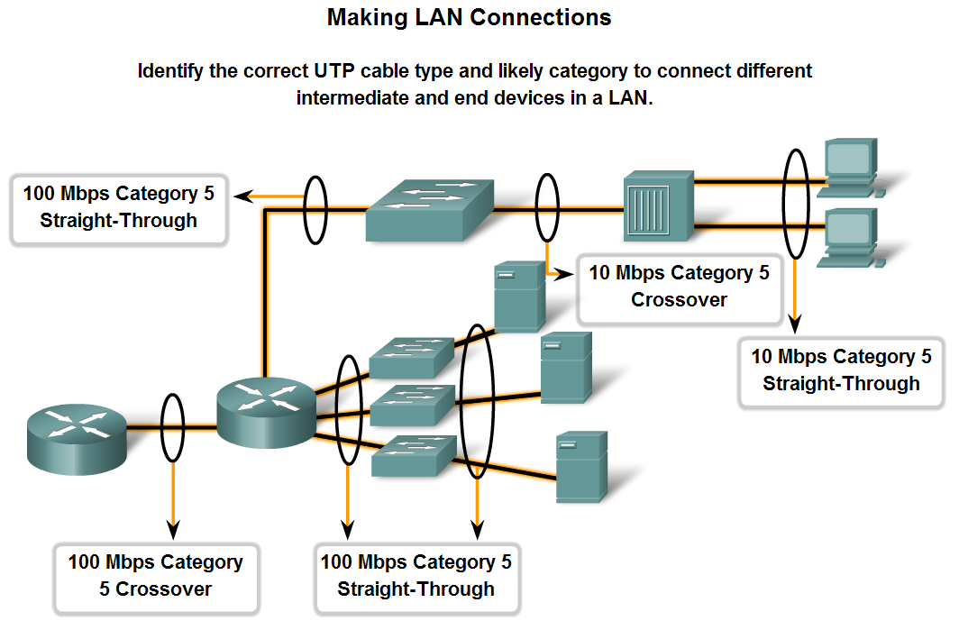
Types of Connections in a LAN
Identify the correct cable to use in connecting intermediate and end devices in a LAN.

Slide 21
Connections
As a reminder, the common uses are listed again:
Use straight-through cables for connecting:
Switch to router
Computer to switch
Computer to hub
Use crossover cables for connecting:
Switch to switch , Switch to hub
Hub to hub. Router to router
Computer to computer , Computer to router

Slide 22
MDI/MDIX
The MDI (media-dependent interface) uses the normal Ethernet pinout.
Pins 1 and 2 are used for transmitting and pins 3 and 6 are used for receiving. Devices such as computers, servers, or routers will have MDI connections.
The devices that provide LAN connectivity - usually hubs or switches - typically use MDIX (media-dependent interface, crossover) connections.
The MDIX connection swaps the transmit pairs internally. This swapping allows the end devices to be connected to the hub or switch using a straight-through cable

Slide 23
MDI/MDIX (Medium Dependant Interface)
Many devices allow the UTP Ethernet port to be set to MDI or MDIX. This can be done in one of three ways, depending on the features of the device:
On some devices, ports may have a mechanism that electrically swaps the transmit and receive pairs. The port can be changed from MDI to MDIX by engaging the mechanism.
As part of the configuration, some devices allow for selecting whether a port functions as MDI or as MDIX.
Many newer devices have an automatic crossover feature. This feature allows the device to detect the required cable type and configures the interfaces accordingly.

Slide 24
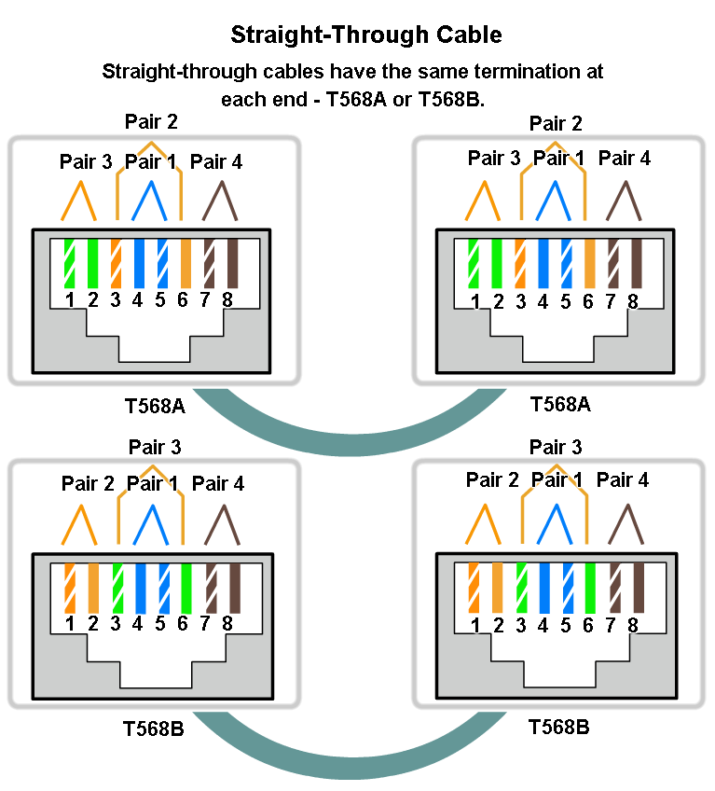
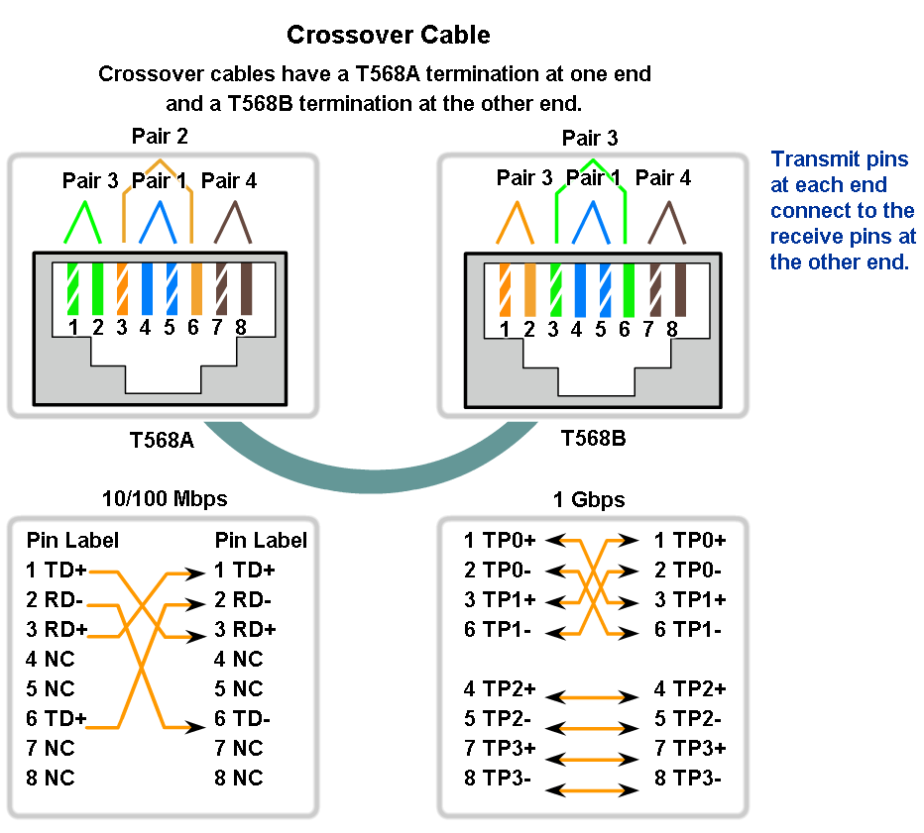
Types of Connections in a LAN
Identify the pinout of the straight-through and cross-over cables

Slide 25
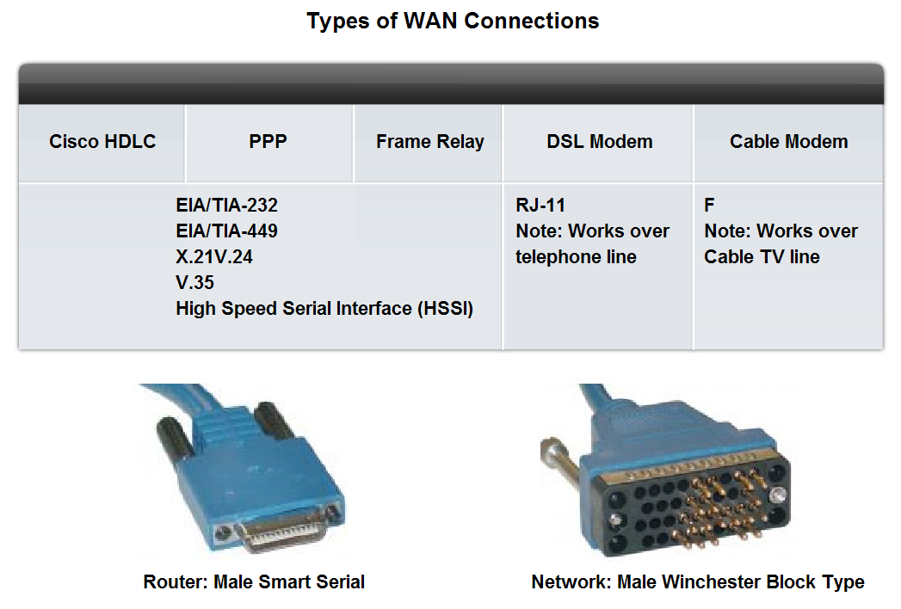
Types of Connections in a LAN
Recognize that a different class of cables is used to connect WANs, and that the cables, standards and ports are different than those in use by LANs.

Slide 26
Serial Cables
Cisco routers have two types of physical serial cables.
Both cables use a large Winchester 15 Pin connector on the network end.
This end of the cable is used as a V.35 connection to a Physical layer device such as a CSU/DSU.
The first cable type has a male DB-60 connector on the Cisco end and a male Winchester connector on the network end.
The second type is a more compact version of this cable and has a Smart Serial connector on the Cisco device end.
It is necessary to be able to identify the two different types in order to connect successfully to the router.

Slide 27
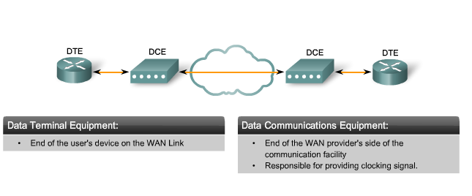
DCE and DTE

Slide 28
DCEs and DTEs
DCEs and DTEs are used in WAN connections.
The communication via a WAN connection is maintained by providing a clock rate that is acceptable to both the sending and the receiving device.
In most cases, the telco or ISP provides the clocking service that synchronizes the transmitted signal.
For example, if a device connected via a WAN link is sending its signal at 1.544 Mbps, each receiving device must use a clock, sending out a sample signal every 1/1,544,000th of a second.
The timing in this case is extremely short. The devices must be able to synchronize to the signal that is sent and received very quickly.
By assigning a clock rate to the router, the timing is set. This allows a router to adjust the speed of its communication operations, thereby synchronizing with the devices connected to it.

Slide 29
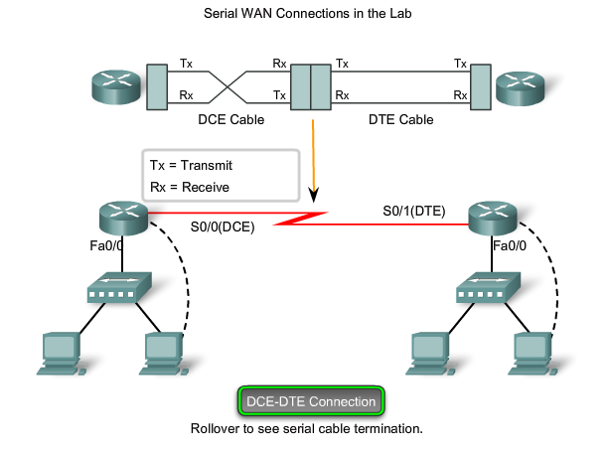
In the Lab Environment

Slide 30
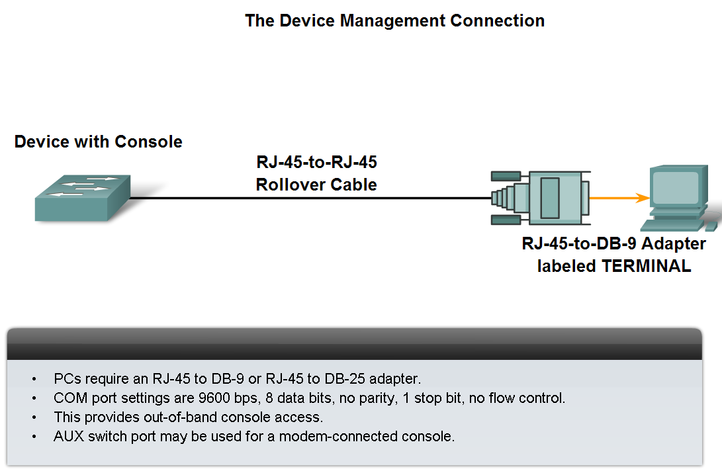
Types of Connections in a LAN
Out-of-band communication is the exchange of call control information in a separate band from the data or voice stream, or on an entirely separate, dedicated channel (as in Common Channel Signalling).

Slide 31
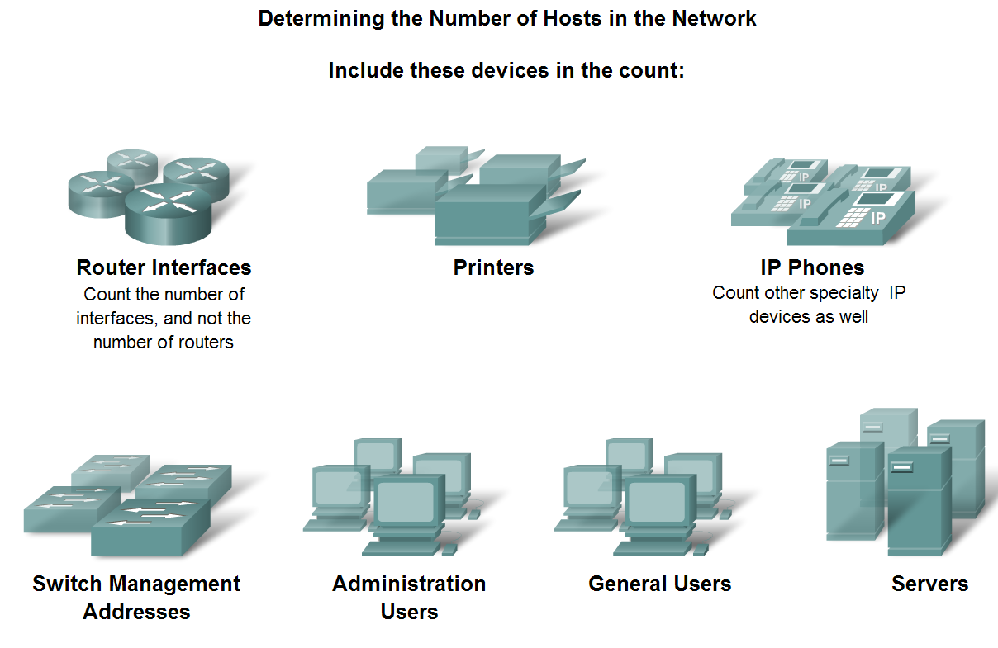
Design an Addressing Scheme for an Inter-network.
Design an address scheme for an internetwork and assign ranges for hosts, network devices and the router interface

Slide 32
Determining Host Addresses
Consider every device that will require an IP address, now and in the future.
There may be other devices on a network requiring an IP address. Add them to this list and estimate how many addresses will be needed to account for growth in the network as more devices are added.
Once the total number of hosts - current and future - has been determined, consider the range of addresses available and where they fit within the given network address.
Next, determine if all hosts will be part of the same network, or whether the network as a whole will be divided into separate subnets.

Slide 33
Why Subnet
There are many reasons to divide a network into subnets:
Manage Broadcast Traffic - Broadcasts can be controlled because one large broadcast domain is divided into a number of smaller domains. Not every host in the system receives every broadcast.
Different Network Requirements - If different groups of users require specific network or computing facilities, it is easier to manage these requirements if those users who share requirements are all together on one subnet.
Security - Different levels of network security can be implemented based on network addresses. This enables the management of access to different network and data services.

Slide 34
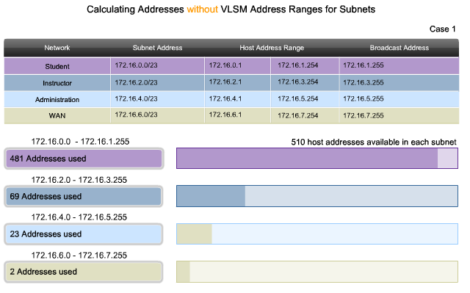
Classful Subnetting

Slide 35
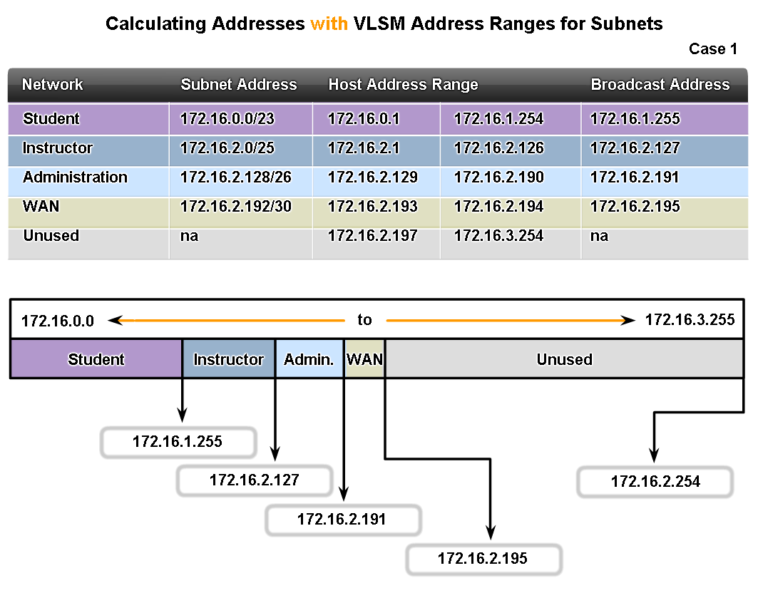
Design an Addressing Scheme for an Inter-network.

Slide 36
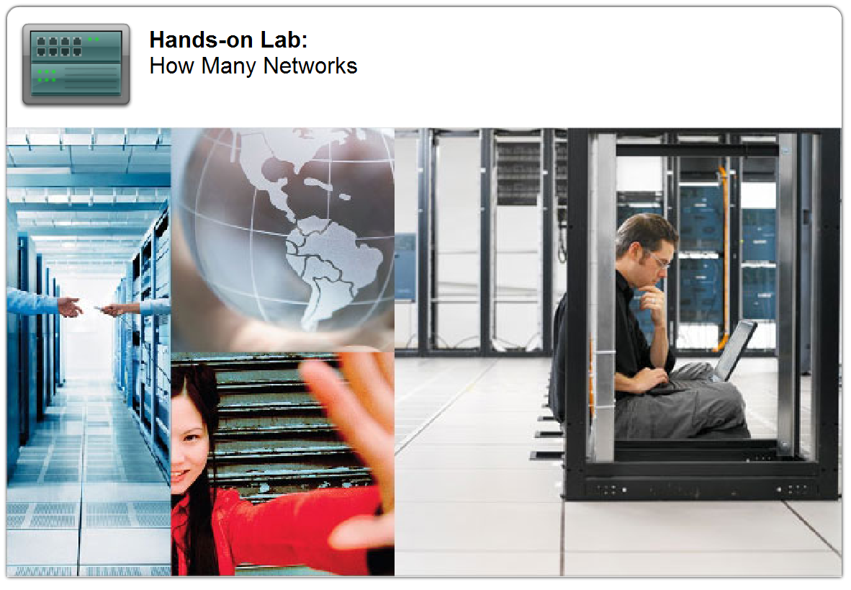
Importance of Network Designs
Given a network scenario, develop an appropriate networking scheme (10.3.2)

Slide 37

Packet Tracer Labs

Slide 38
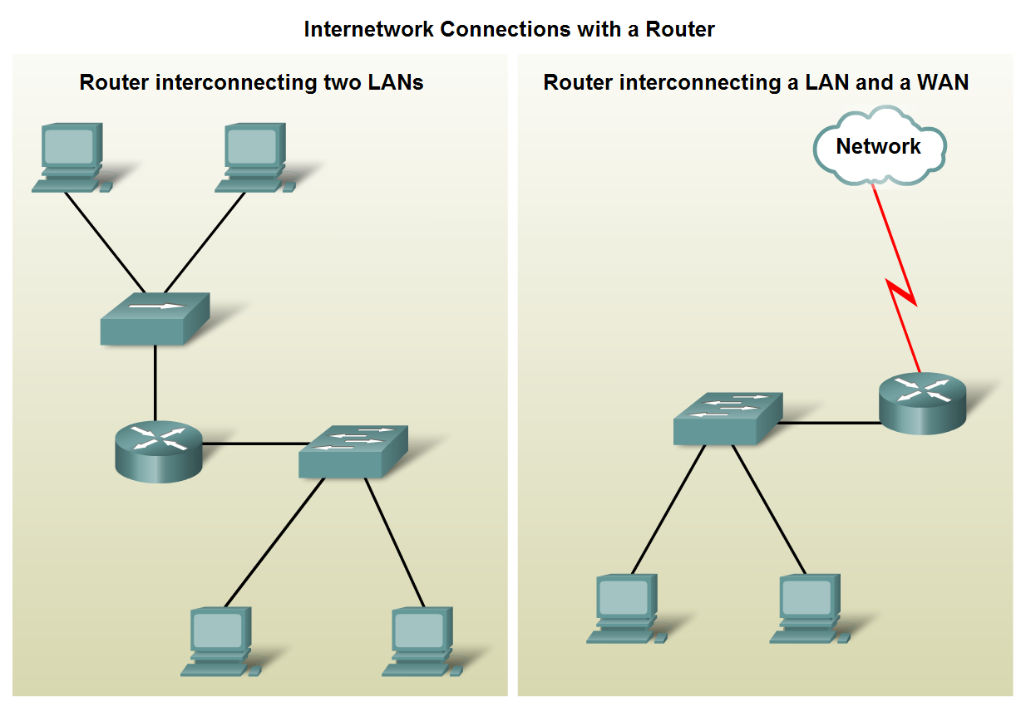
Importance of Network Designs
Given a network requirement, determine the optimum number of sub networks in the larger internetwork.

Slide 39
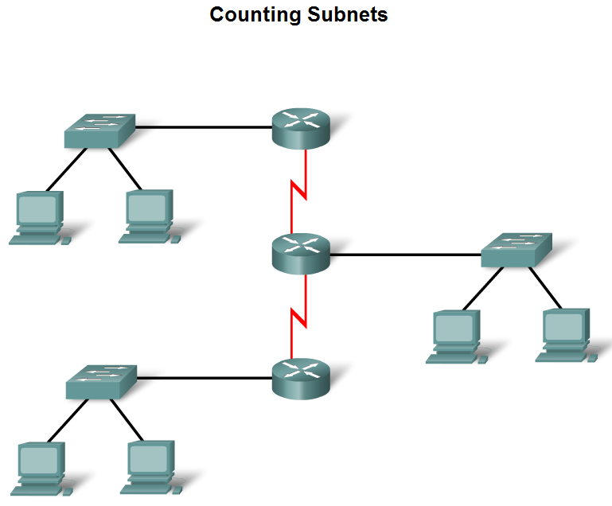
Importance of Network Designs
Describe how to count the segments between router interfaces.

Slide 40
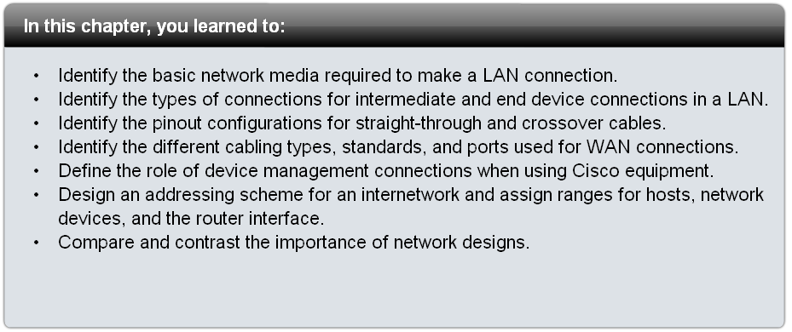
Summary

